Slide 1


Infection Prevention & Control Standard Precautions Training – Domiciliary Care
Infection Prevention & Control Team

Slide 2
Aims and outcomes of this session
To improve your knowledge around preventing and controlling the spread of infection
To promote IPC best practice amongst all staff
To understand your own responsibilities in relation to infection prevention and control
To gain a greater awareness of outbreaks of infection
To understand the importance of hydration and how it can reduce the risk of Urinary Tract Infection

Slide 3
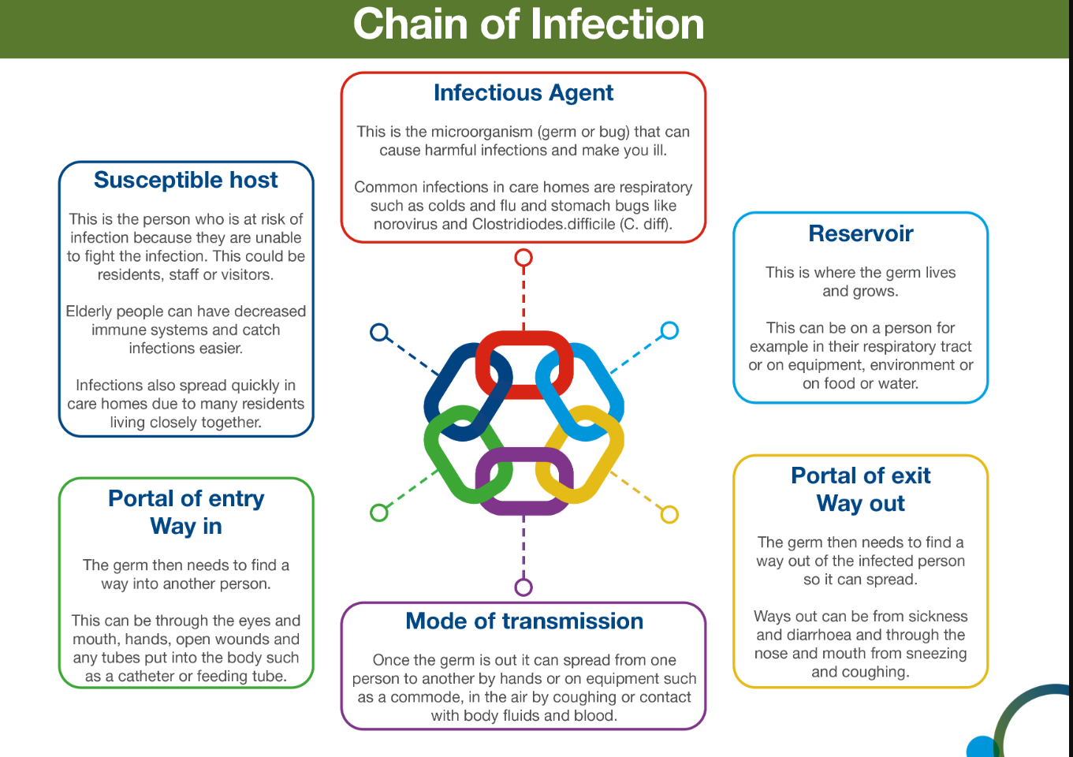


Slide 4
Standard infection control precautions (SICPs)
The National Infection Prevention and Control Manual (updated May 2024) for England states that SICPS are to be used by all staff, in all care settings, for all service users whether infection is known to be present or not NHS England » National infection prevention and control manual (NIPCM) for England
1. Patient placement | 6. Safe management of care equipment
2. Hand hygiene | 7. Safe management of healthcare linen
3. Respiratory and cough hygiene | 8. Safe management of blood and body fluids
4. Personal Protective Equipment (PPE) | 9. Safe disposal of waste (including sharps)
5. Safe management of the care environment | 10. Occupational safety / managing prevention of exposure (including sharps)

Slide 5
Assessment of infection risk
Assessing for infection risk prior to attending or on arrival to the care setting or service users own home, is vital
Those who may present as an infection risk include people with diarrhoea & or vomiting, respiratory symptoms, or people with a known infection
Continue to assess infectious risk throughout their period of care in case of any changes
If a person is identified as having an infection risk, this should be reflected in their care planning and communicated with colleagues

Slide 6
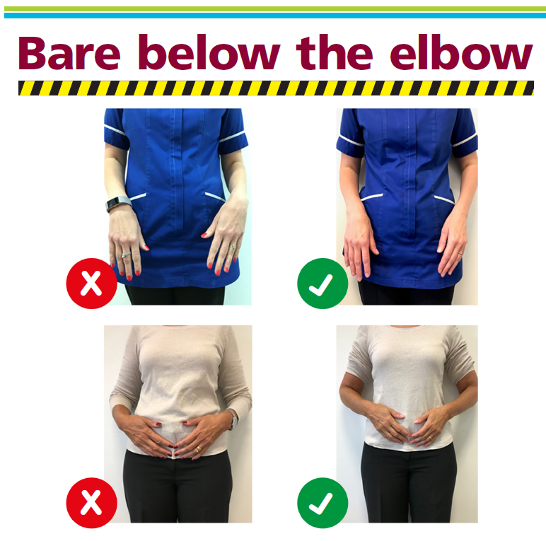
Hand hygiene
Hand hygiene is considered one of the most important ways to reduce the transmission of infection
Points to remember
Staff MUST be bare below the elbow
Hand hygiene MUST be performed using the WHO 5 moments for hand hygiene
Use Ayliffe technique when decontaminating hands
Choose the correct hand hygiene products e.g. liquid soap and water should be used when your hands have been exposed to bodily fluids or suspected/known gastrointestinal infection
Alcohol gel – used when hands are visibly clean
Staff must have access to liquid soap, paper towels and alcohol gel at all times – this may mean staff utilise hand hygiene packs

Slide 7
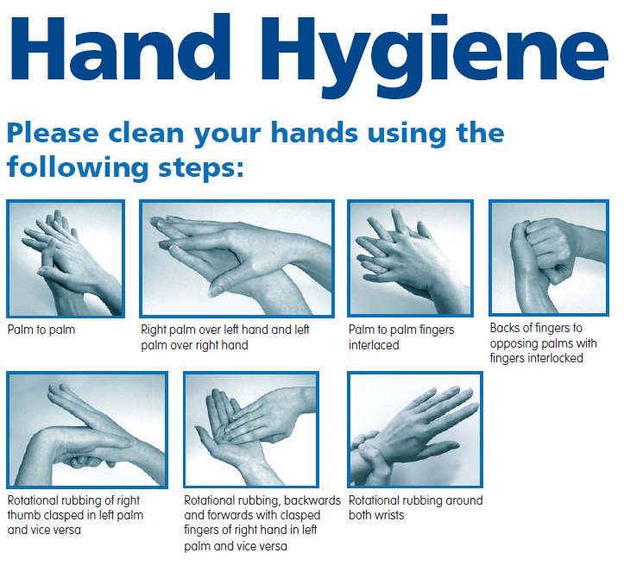

Slide 8
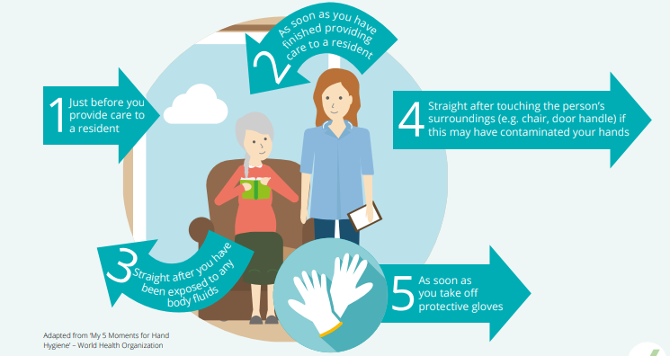
Hand hygiene:
The 5 moments for hand hygiene

Slide 9

Respiratory and cough hygiene
Cover nose and mouth with a disposable tissue when sneezing
Prompt disposal of all used tissues into waste bin
Wash hands after coughing, sneezing, using tissues
Keep contaminated hands away from eyes and nose

Slide 10
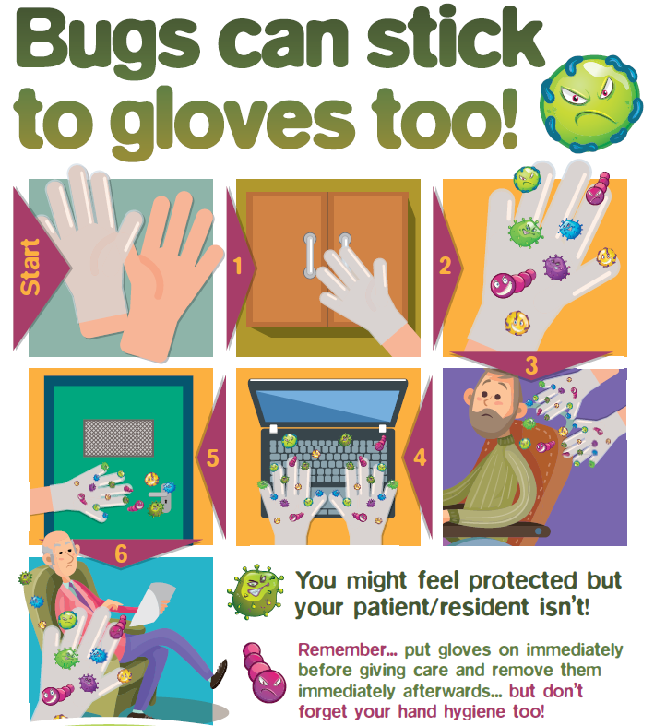
Personal Protective Equipment (PPE)
Before undertaking any procedure, staff should assess any likely exposure to infection, blood and/or other body fluids and wear PPE that adequately protects them
PPE must be:
  Located/applied close to point of use and - (for domiciliary visits PPE must be transported in clean receptacle)
  Single use, unless specified by manufacturer
  Applied and removed correctly and in the correct order
  Changed immediately after each person/procedure or task
  Disposed of correctly
  Hand hygiene must be undertaken prior to putting on/taking off PPE

Slide 11

Personal Protective Equipment (PPE)
Gloves/Aprons must be:
  Changed if perforated/ripped/contaminated
  Appropriate for use, fit for purpose and well-fitted
  Alcohol gel should not be used on gloves
    Eye protection must be:
  Worn if risk of blood and/or body fluid exposure to the eyes or face is anticipated or likely
  Worn when caring for a person suspected or confirmed COVID 19/respiratory illness

Slide 12
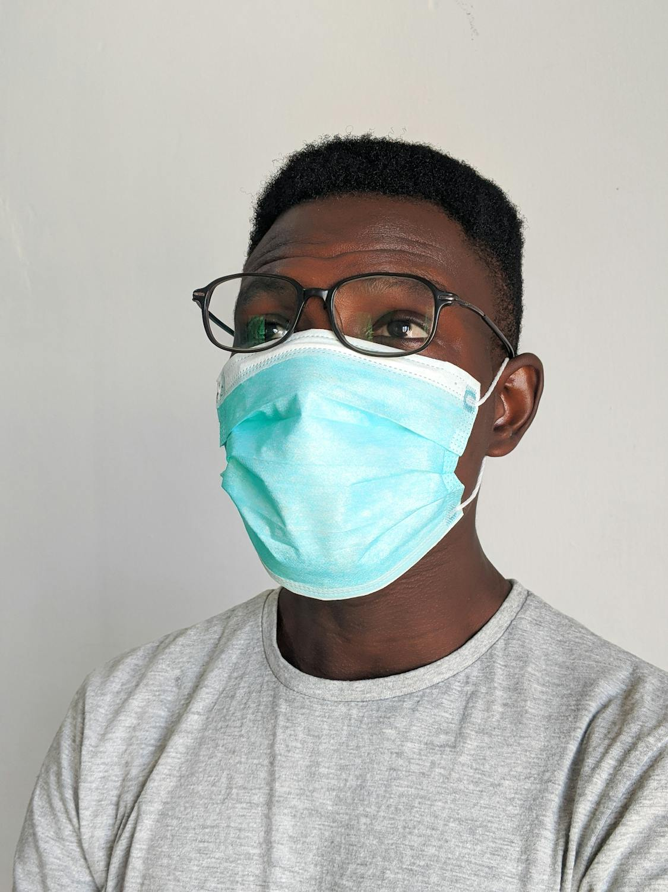
Personal Protective Equipment (PPE)
Fluid Resistant Surgical Facemask (FRSM) act:
  To protect the person you are caring for
  To protect yourself
Key points:
  Wear with eye protection if splashing or spraying of blood/body fluids
  Well fitting and fit for purpose, fully covering the mouth and nose
  Worn correctly and not to be touched once put on
  Should be changed if they become moist, damaged, contaminated or soiled
  Worn in line with current guidance

Slide 13
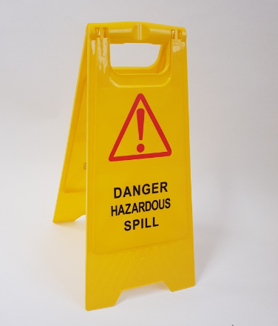
Safe management of blood and body fluid spillages
Blood and body fluids may contain high concentration of micro organisms
Refer to appendix 9 (IPC manual) – Best management of blood and body fluid spills
N.B. 10,000 parts per million available chlorine solution is required for blood/some bodily fluid spills
Consider use of spill kits if available within the setting

Slide 14
Management of Inoculation Injuries
Wash site with soap and water and cover
Inform manager
Complete incident report
No further action
Skin Intact
Penetration of sterile sharp object
Encourage bleeding
Do not suck
Wash site with soap and water and cover
Identify and dispose of sharps correctly
Inform manager
Penetration or abrasion of skin by a contaminated sharp object, instrument, needle, human bite or scratch involving broken skin
Refer to employer’s policy
Blood splash – into eyes, nose, mouth or broken skin
Irrigate with copious amounts of water (before and after removal of contact lenses)
Water to rinse the mouth should not be swallowed
Inform manager

Slide 15
What is an outbreak
An outbreak is defined as 2 or more positive (or clinically suspected) linked cases – (staff and or service users)
Prompt recognition, response/management and reporting of suspected outbreaks is essential to minimise spread of infection – report to IPC service 0151 604 7750 (out of hours UKHSA – 0344 225 0562) staff should be aware of how to manage evolving situations.
Educate staff on how to recognise signs of an outbreak and what actions they should take.
Effective prompt recognition and management of outbreaks can reduce spread within care settings and help to keep everyone safe

Slide 16
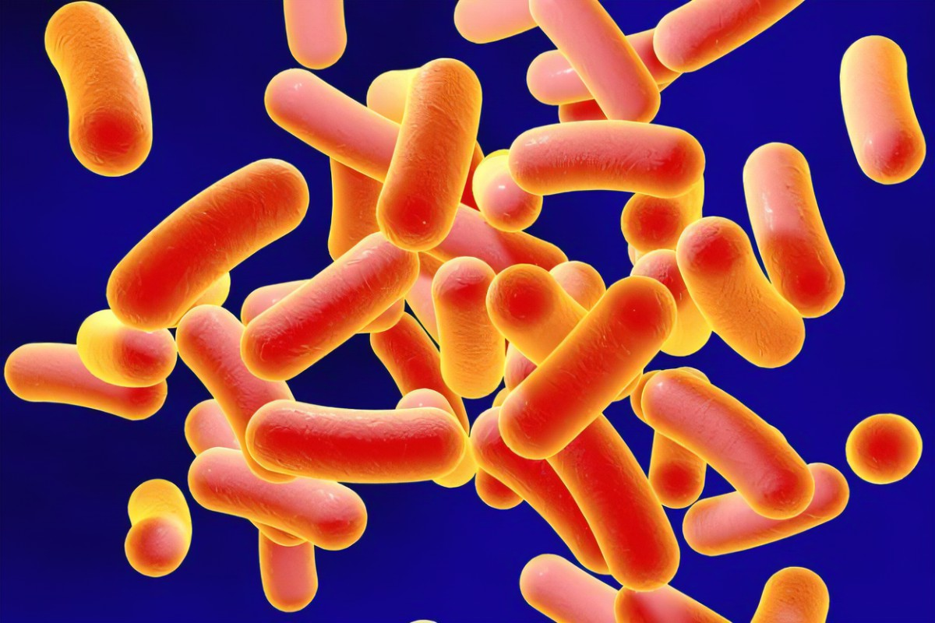
Clostridioides difficile
What is it ?
Clostridioides difficile (also known as C.difficile, C.diff or CDI) is a spore forming bacteria which can be found in the large intestine. Some antibiotics can disturb the balance of the gut flora and cause diarrhoea, this can cause the C.diff to multiply and produce toxins. The toxins may damage the lining of the intestine and produce symptoms ranging from watery diarrhoea to life threatening colitis.
Risk factors include:
Age over 65 years or over
Recent treatment with broad spectrum antibiotics
Recent contact with healthcare settings
On proton pump inhibitor
Underlying health disease

Slide 17
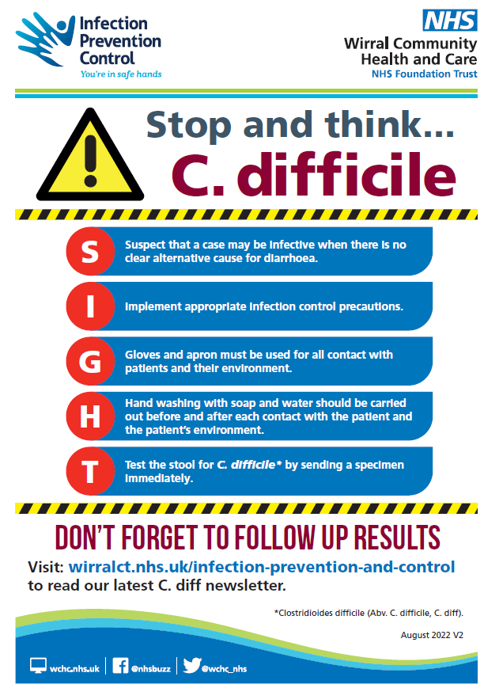
Clostridioides difficile
Transmission
Faecal oral route
Direct person to person contact
Contaminated hands
Contaminated environment -spores can live in the environment for months

Slide 18

Preventing the spread of antibiotic resistance…
What can we do….
Always follow correct advice when using antibiotics i.e. take antibiotics as prescribed
Talk to the service user about how to take antibiotics correctly, antibiotic resistance and the dangers of misuse
Prevent infections by regularly washing hands – poor infection prevention & control can increase the spread of drug-resistant infections
Become an antibiotic guardian https://antibioticguardian.com/

Slide 19

Hydration
Encourage fluids to help reduce the risk of Urinary Tract Infection (Unless on a fluid restricted diet)
Little and often offers and prompts - make every contact count
Fruit and veg
High water content fruit and veg
Melons; watermelon, cantaloupe (92% water)
Strawberries / peaches
Citrus; oranges, grapefruit, tangerines – also high in fibre
Cucumber / lettuce / celery
Tomatoes / peppers
Tinned pears – can be mashed easily

Slide 20
References
Policies - Infection Prevention Control
Infection prevention and control in care homes - Care Quality Commission (cqc.org.uk)
https://www.england.nhs.uk/publication/national-infection-prevention-and-control/
https://www.england.nhs.uk/publication/national-standards-of-healthcare-cleanliness-2021/
https://antibioticguardian.com/
https://www.wchc.nhs.uk/services/infection-prevention-and-control/

Slide 21
Thank you for listening….
Contacting the team:-
Our email address ipc.wirralct@nhs.net or by telephone 0151 604 7750
IPC DIGITAL HUB- Infection Prevention and Control - Wirral Community Health and Care NHS Foundation Trust (wchc.nhs.uk)
Please complete post session evaluation via the QR code

