Slide 1
Winter preparedness
Infection Prevention Control Service
September 2023

Slide 2
Objectives
Reinforce key IPC preventative practices
Highlight the importance of vaccination
Recognising the signs of Acute Respiratory Illness and Norovirus
Outbreak response
Self care

Slide 3
Vaccination
Flu and COVID-19 vaccination provides vital protection
It helps keep people from developing serious illnesses and helps reduce the chance of being admitted into hospital
Vaccinations are our best defence against flu and COVID-19 ahead of what could be a very challenging winter
Encourage your staff to get vaccinated
It is important to keep a record of your service users vaccinations in the event of an outbreak

Slide 4
How to access to Winter Vaccinations Covid/Flu
All Front-Line Health & Social Care Workers are eligible
Covid Booster
At your place of work
National Booking System
Via your GP
Call 119 free of charge to book over the phone if you cannot book online.
You can find a walk-in COVID-19 vaccination site to get a vaccine without an appointment
Flu Vaccine
*Identification needed to prove you are a social care worker or carer
You may need to present proof of your employment. You can use:
a letter from your employer
an ID badge
a payslip
Through your Employer
Own GP*
Pharmacy*

Slide 5
Hand Hygiene
Ensure that your hand hygiene facilities are easily accessible, clean and in good working order
All staff to be responsible for ensuring sufficient stocks of hand hygiene products within dispensers
Choose the right product
Alcohol hand rub can be used when hands are visibly clean
Liquid soap and water must be used when
hands are visibly soiled or you have been in contact with bodily fluids
when caring for a service user with a suspected or known gastrointestinal infection, e.g., norovirus or Clostridioides difficile

Slide 6
PPE-Personal Protective Equipment
To supports staff knowledge around putting on and taking off PPE use the competency assessments available on the digital hub https://www.wchc.nhs.uk/ipc-topics/personal-protective-equipment-ppe-competency-assessment-tool/
Begin a regular programme of PPE audits https://www.wchc.nhs.uk/ipc-topics/auditing-care-home-settings
Familiarise yourself with the IPC manual chapter 1.4 https://www.wchc.nhs.uk/content/uploads/2023/03/National-infection-prevention-and-control-manual-v2-4-250123-1.pdf to guide level of PPE required and any special requirement for e.g., fit testing for FFP3 respirators
All staff should be responsible for ensuring sufficient stocks of PPE, that they are stored away from the risk of contamination and that stock is in date

Slide 7
Respiratory Hygiene
Ensure you have a good supply of tissues within your setting, and they are readily available for use
Encourage residents and staff to use catch it, kill it, bin it
Tissues should be disposed of as soon as possible

Slide 8
Antibiotics and Viruses
Many illnesses get better on their own without using antibiotics.
Antibiotics will not work for viral infections such as colds and flu, and most coughs.
Antibiotic resistance is a big problem – taking antibiotics when you do not need them can mean they may not work for you in the future.
If you require antibiotics, make sure you take the full course
Become an antibiotic guardian https://antibioticguardian.com/

Slide 9
Cleaning and Disinfection
During increased incidences or outbreaks of infection additional cleans (enhanced cleans) will be required of frequently touched surfaces i.e., door handles, grab rails and table tops.
Cleaning removes dust and dirt
Disinfection kills germs – disinfection can only happen once cleaning has taken place
If a service user has a suspected or confirmed infection their equipment and environment will require cleaning and disinfecting
Cleaning checklists templates are available on the IPC website
Ensure cleaning and disinfectant products are readily available

Slide 10
Recognise the signs and symptoms of ARI
ARIs can include
Flu
COVID-19
Respiratory syncytial viruses (RSV)
Symptoms can include
continuous cough high temperature, fever or chills
loss of, or change in, your normal sense of taste or smell
shortness of breath
unexplained tiredness, lack of energy
muscle aches or pains
not wanting to eat or not feeling hungry
headache
sore throat, stuffy or runny nose
diarrhoea, feeling sick or being sick

Slide 11
Recognise the symptoms of norovirus
Norovirus
Also known as the ‘winter vomiting bug’
It spreads easily and quickly
Symptoms can include
suddenly feeling sick
projectile vomiting
watery diarrhoea
Some people also have a slight fever, headaches, painful stomach cramps and aching limbs.
The symptoms appear one to two days after you become infected and typically last for up to two or three days.
https://www.youtube.com/watch?v=sLDSNvQjXe8

Slide 12
Staying well
Staying hydrated
Eating a well-balanced diet
Encouraging unwell staff to avoid the workplace until their symptoms have settled and in line with local policy
Advise Visitors to not visit if unwell
Keep areas well-ventilated to reduce the risk of respiratory infections but staying warm
Keeping warm over the winter months can help to prevent colds, flu and more serious health problems such as heart attacks, strokes, pneumonia and depression
Look after chronic conditions

Slide 13
Preparing for outbreaks
Familiarise yourself/staff with the current Flu, COVID-19 and norovirus guidance for ASC
Ensure you/staff are aware of clinical definition of Covid 19 and Flu. This is important when managing ARI outbreaks as antivirals (AV) may be required.
Maintain an accurate and up to date record of all residents and their eligibility status this is in the event you have a respiratory outbreak (as per ARI template in resource pack includes Flu vaccination status and latest kidney function test) this will be required if antiviral prophylaxis is indicated.
Ensure a supply of LFT testing kits in the event of a suspected outbreak of COVID-19 . Apply for coronavirus test kits - GOV.UK (test-for-coronavirus.service.gov.uk)
Display IPCS Contact details within the setting

Slide 14
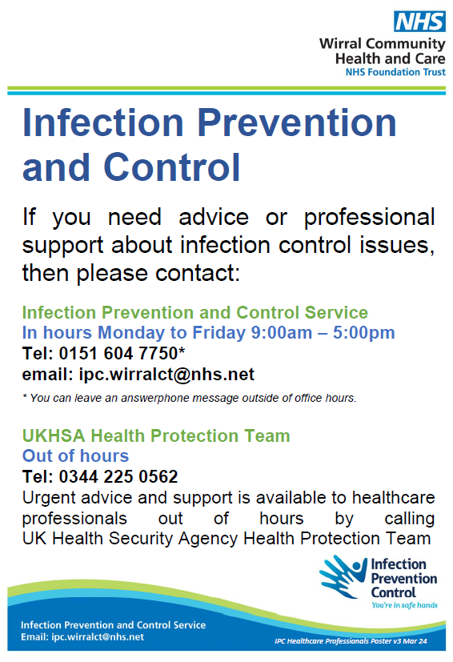
Recognising and reporting an outbreak
Suspect an outbreak when 2 or more cases are identified within that are linked to the setting
Once an outbreak is suspected enhanced IPC control measures should be initiated
Prompt recognition, response and reporting of suspected outbreaks is essential to minimise spread of infection – report to IPC service Monday to Friday 9-5 excluding bank holidays on 0151 604 7750 or email ipc.wirralct@nhs.net (out of hours contact UKHSA – 0344 225 0562)

Slide 15
Simple things to stay well this winter
COVID-19 supplement to the infection prevention and control resource for adult social care - GOV.UK (www.gov.uk)
Simple Things (simplethings-nhs.com)
NHS England » National infection prevention and control
Coronavirus (COVID-19) testing for adult social care services - GOV.UK (www.gov.uk)
Vomiting Larry - A demonstration and explanation from his creator – YouTube
Antibiotic Guardian | Pledge to be an Antibiotic Guardian
Infection Prevention and Control - Wirral Community Health and Care NHS Foundation Trust (wchc.nhs.uk)

