Slide 1
Infection Prevention Control Service – IPC champions
Audit

Slide 2
Where to find your self audit tools IPC digital Hub

Slide 3
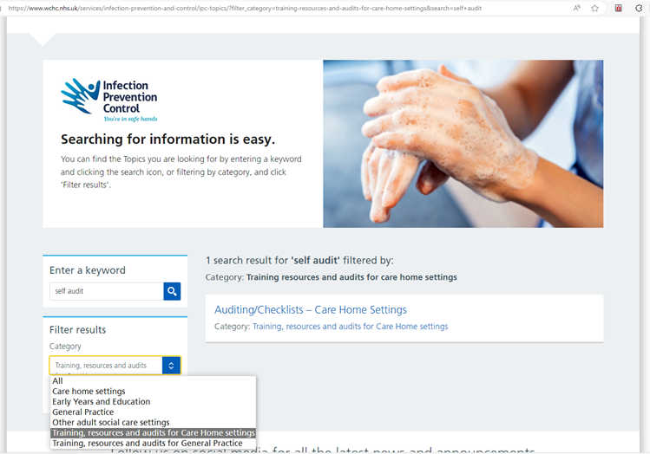
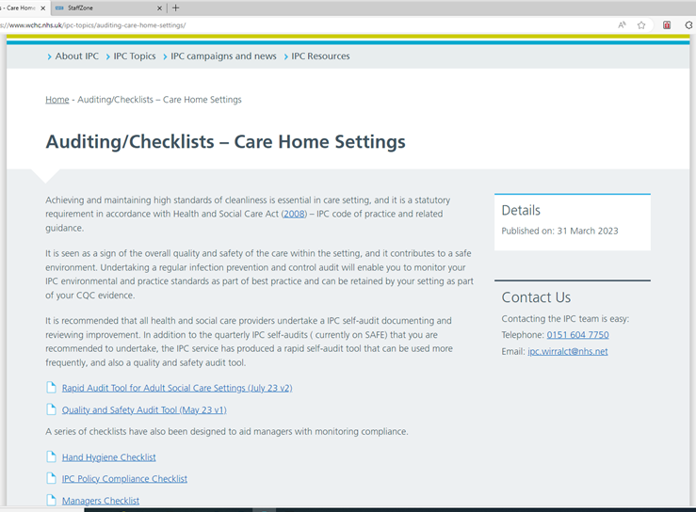
Where to find your self audit tools… IPC digital Hub
Infection Prevention and Control - Wirral Community Health and Care NHS Foundation Trust (wchc.nhs.uk)
Auditing/Checklists - Care Home Settings - Wirral Community Health and Care NHS Foundation Trust (wchc.nhs.uk)

Slide 4
Lets look at the audit tool..

Slide 5
How often should we be completing Audit
Quality and Safety Audit (Full Audit tool) recommended to be done annually
Rapid audit tool for adult social care settings – recommended to be done quarterly
Both should have action plans that are monitored regularly

Slide 6
Thank you for listening

