Slide 1
Annual Members’ Meeting 2022-23
Tuesday 19 September 2023

Slide 2
Agenda
Welcome Professor Michael Brown CBE DL - Chair
Review of the year Karen Howell - Chief Executive
Financial Review Mark Greatrex - Chief Finance Officer
Quality Account Paula Simpson - Chief Nurse
Report from the Council of Governors Alison Hughes - Director of Corporate Affairs
Looking ahead Karen Howell OBE – Chief Executive
Questions & Answers Professor Michael Brown - Chair
Annual Members’ Meeting 2022-23

Slide 3
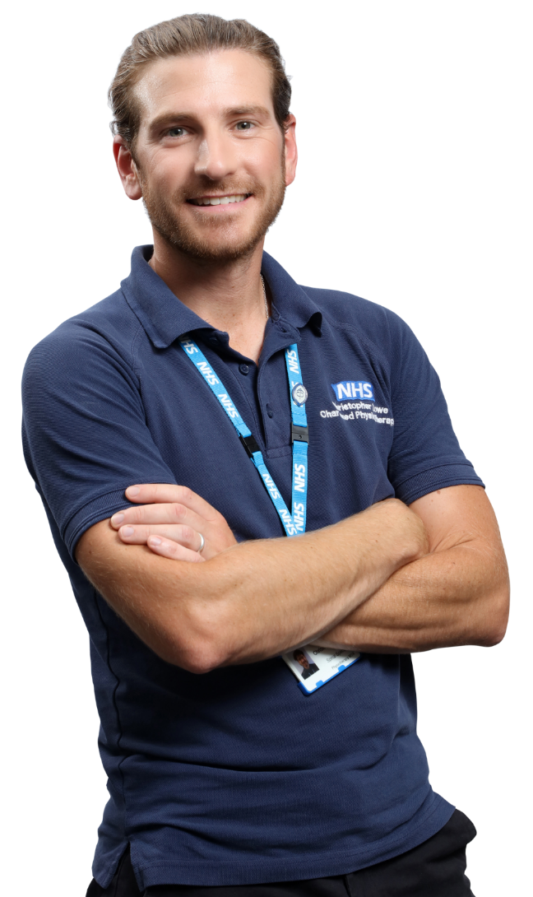
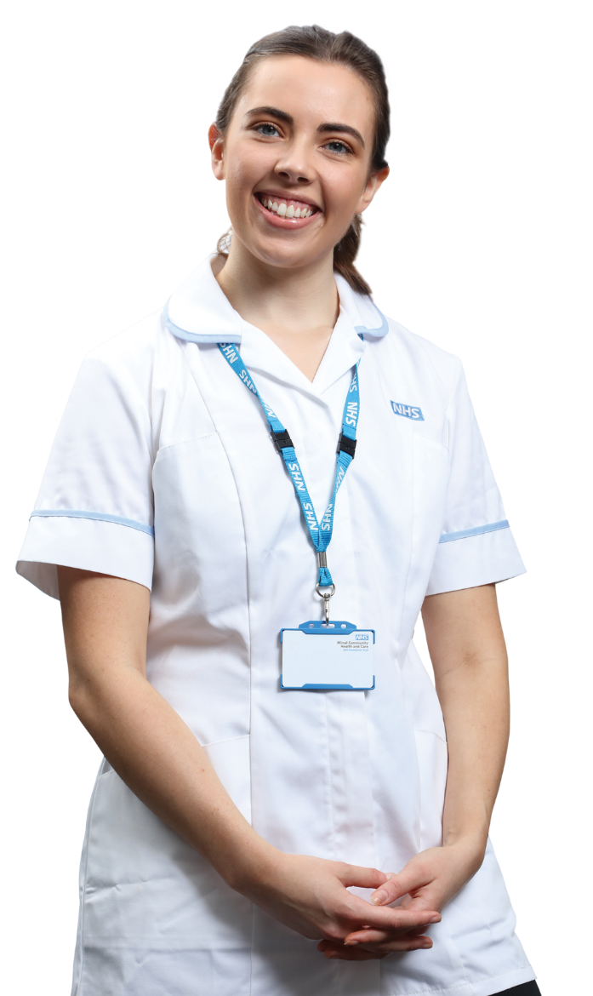
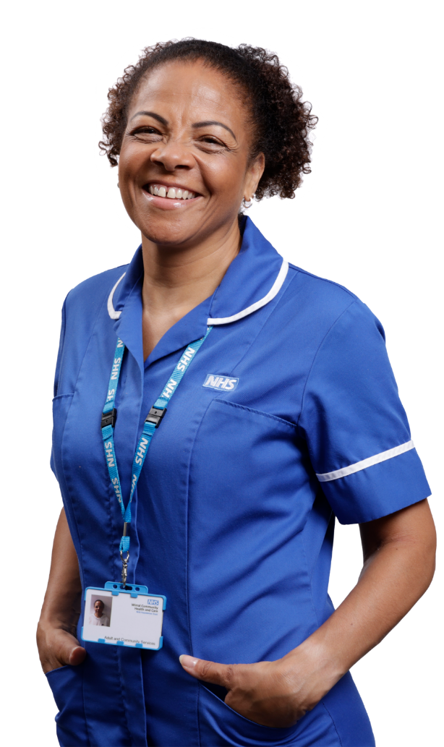
Review of the year
Karen Howell OBE Chief Executive
Annual Members’ Meeting 2022-23

Slide 4
What some of our service users and their families have said about us…
“A massive thank you to Nurse Practitioner Dave and Student Nurse Cath at the Urgent Care Centre. Their kindness, humour and rapport skills were second to none - I can't praise them enough”.
Urgent Treatment Centre
“Lisa has been our assigned health visitor over the last 12 months or so. She has been incredibly supportive to my son and our family”.
0-19+ Health and Wellbeing Service, Cheshire East
"Care has been outstanding all the way through, listens well and is compassionate. Puts me at ease when anxious and helped me move forward. Help night and day.”
Community Intermediate Care Centre (Bluebell Ward)
“Amazing care and compassion, did more than was asked, over and above their remit, ultimate praise for Kathryn”.
Community Integrated Response Team - Rapid Community Response
“First class, professional, caring, compassionate service for which I am very grateful. Cannot praise it enough”.
Bladder and Bowel Service
During 2022-23 service user feedback was very positive with 93% of people recommending the Trust, from almost 28,000 responses
Annual Members’ Meeting 2022-23

Slide 5
Review of performance 2022-23
Overview
A sustained commitment to delivering high quality community health and care services
Resilience, determination, and compassion of our staff
Significant contribution to the ‘system’ response and recovery following the Covid-19 pandemic
Introduced new and innovative ways of working and service delivery models
We demonstrated our commitment to sustainability through the construction of Marine Lake Health and Wellbeing Centre
Signatories of the Cheshire and Merseyside Social Value and Anchor Institution Charters
Annual Members’ Meeting 2022-23

Slide 6
Vision, values, objectives and goals
Annual Members’ Meeting 2022-23
Notes:
We are a population health focused NHS organisation specialising in supporting people to live independent and healthy lives.
During 2022-23 the Trust progressed the delivery of the first year of the Trust’s five-year Organisational Strategy 2022-27, and work was delivered against each of our We Will statements as planned for year one. The enabling strategies (Quality, Inclusion, Digital and People Strategies) are supporting the organisational vision with clear demonstration of their contribution to the Organisational Strategy.

Slide 7
Performance delivered in line with our 5 year and supporting strategies
Annual Members’ Meeting 2022-23

Slide 8
Review of performance 2022-23
Key achievements
Our services delivered 1,388,871 contacts
During 2022-23 the Trust demonstrated consistent good performance against all key performance indicators
More than 90% of patients admitted to the CICC were sufficiently re-abled to return home on discharge
Two Hour Urgent Community Response performance exceeded the national targets set (70%) with 88% of patients seen within 2 hours. This also compares favourably locally and nationally with other Community Trusts.
We established a HomeFirst pilot project providing therapy and personal care for people needing support to go home from a ward.
“My wife’s improvement has been astonishing. I cannot praise the service enough… look forward to further visits and continual improvement. Thank you so much for offering the service.”
Annual Members’ Meeting 2022-23
Notes:
The Trust is monitored against many Local Authority, ICB and NHSE-driven Key Performance Indicators (KPIs) which are reported through formal contract monitoring meetings.
During 2022-23 the Trust demonstrated consistent good performance against all key performance indicators, despite waiting list challenges, ending the year with 53 green, 9 amber, 24 red KPIs.

Slide 9
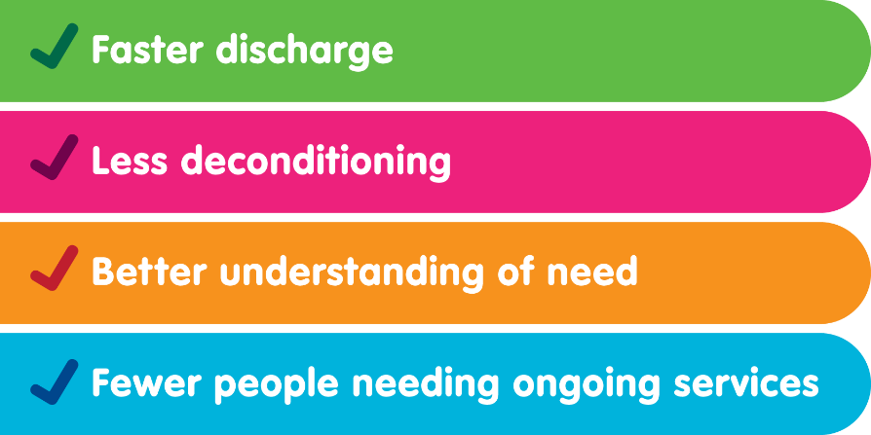
HomeFirst
Therapy
Reablement
Personal care
Assessment
Annual Members’ Meeting 2022-23

Slide 10
Review of performance 2022-23
Key achievements
98.5% of all patients attending Trust Urgent Care Services and Walk-in Centres were seen and treated within 4 hours
In 2022-23, performance across the core contacts in all 0-19/ 0-25 services improved significantly
The Knowsley 0-25 service saw the biggest growth in terms of offer, and this is reflected in our improvement journey across all KPIs
By March 2023, 18 of the 19 Trust services with active waiting lists had achieved the target of a wait for first appointment time under 52 weeks – a significant improvement on 2021/22
Annual Members’ Meeting 2022-23

Slide 11
Social Value
Key successes
Signed up to Cheshire and Merseyside Social Value and Anchor Institution Charters
Marine Lake build: community engagement in design and work with Age UK Wirral to develop community spaces and wellbeing offers driven by social value (officially opened July 2023)
Proud to support our Armed Forces Community as a Veteran Aware NHS Trust. We have achieved both Bronze and Silver Defence Employer Recognition Scheme Award accreditation.
Achieved the Rainbow Badge Bronze Award demonstrating our commitment to supporting inclusive and equitable access to our services
Annual Members’ Meeting 2022-23

Slide 12
Review of performance 2022-23
Our staff
We continue to prioritise the wellbeing of our staff providing support and care
The launch of our Inclusion Strategy and strengthening of our staff networks
Wellbeing advice and activities and an Employee Assistance Programme accessible 24/7 and 365 days of the year
Promotion of Freedom to Speak Up (FTSU), supporting staff to raise any concerns remains a priority
The launch of an employee benefits platform Vivup which offers financial lifestyle offers
Strong appraisal performance focussed on health and wellbeing, setting work priorities and support
Active recognition programme including weekly Shoutouts, monthly Standouts and our annual Team WCHC Awards
Annual Members’ Meeting 2022-23

Slide 13
Review of performance 2022-23
New arrangements with the Health & Social Care Act 2022
We have embraced the new arrangements with the introduction of Integrated Care Boards (ICBs) and actively support the Cheshire & Merseyside system
Representatives of the Board participate in system-wide meetings including the Mental Health, Learning Disability and Community Provider Collaborative
We work closely with system partners across all sectors in the Wirral Place and are members of the Place-Based Partnership Board
We have supported and contributed to the development of governance arrangements at Wirral Place
We recognise that the arrangements continue to emerge and as such have a standing agenda item on our public Board of Directors meeting
Annual Members’ Meeting 2022-23

Slide 14
Review of performance 2022-23
Adult Social Care
The contract transferred back to Wirral Council following a recommendation made by the Adult Social Care and Public Health Committee in October 2022
The Trust worked collaboratively with Council colleagues to ensure a safe and effective transfer
We are proud the service transferred back in a strong position, well-equipped to continue delivering high quality provision for Wirral residents
During the 5-year contract, we evidenced significant innovation and improvement
The Trust invested significantly in developing the existing and future workforce and built integrated health and care teams providing holistic personalised care
We are committed to ensuring the best of integration is maintained between health and social care teams
Annual Members’ Meeting 2022-23

Slide 15
Awards and…
accreditations
Annual Members’ Meeting 2022-23

Slide 16
Finance review
Mark Greatrex Chief Finance Officer/Deputy Chief Executive
Annual Members’ Meeting 2022-23

Slide 17
Finance Review
The Trust met all its statutory financial duties for 2022/23
Financial performance was strong – There was a planned surplus of £684k however the Trust delivered a surplus of £768k exceeding the plan by £84k
The Trust delivered £4.1m of savings of which £1.9m was recurrent
Spent £9.4m on capital assets/infrastructure investment
Received income of £115.8m for delivering healthcare services
Annual Members’ Meeting 2022-23

Slide 18
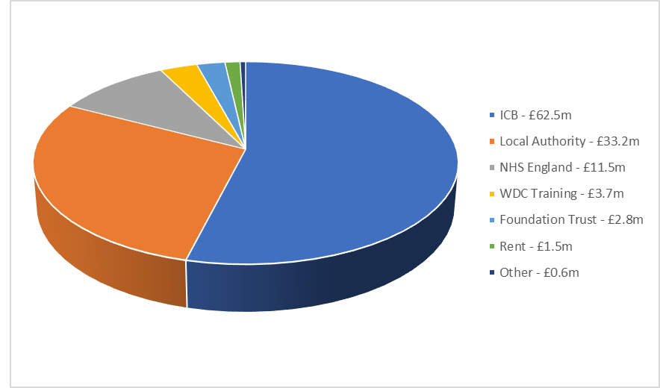
Where does our funding come from?
Received £115.8m for delivering health and care in 2022/23
Annual Members’ Meeting 2022-23

Slide 19
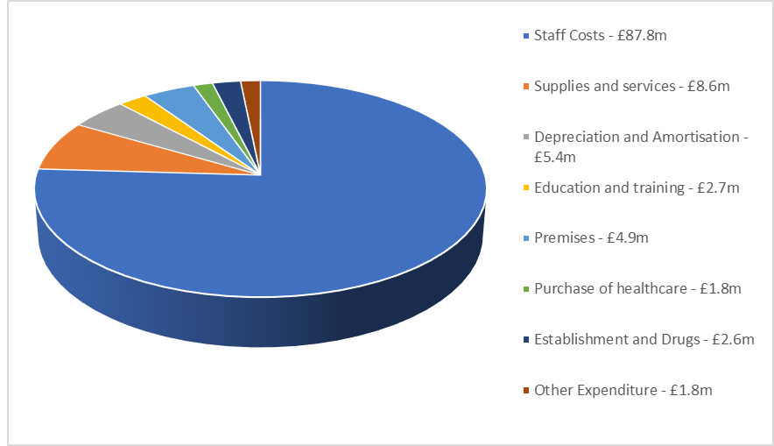
How do we spend our funding?
Spent £115m in the delivery of our services
Annual Members’ Meeting 2022-23

Slide 20
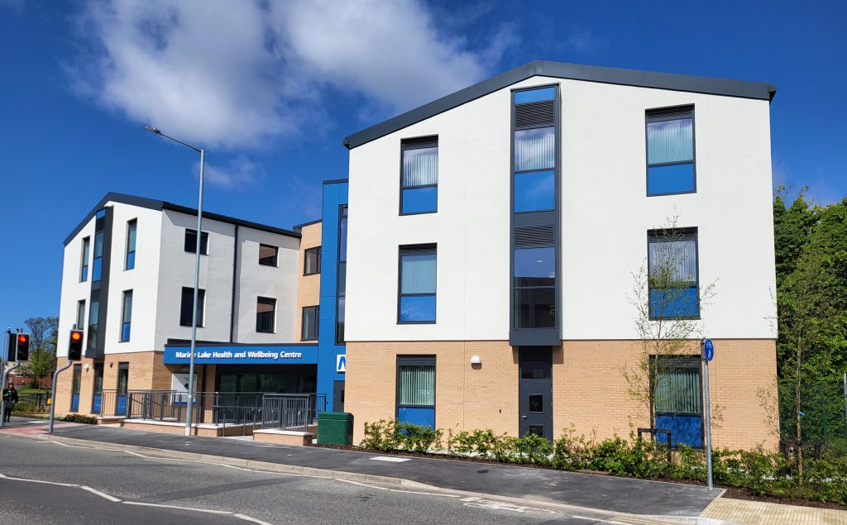
Capital Investment
Capital spend of £9.4m on:
£6.7m – Marine Lake Development
£2.0m – Digital and IT computer replacements, infrastructure and network investment
£0.7m - Estate refurbishment and works, including backlog maintenance and VCH Dental Clinic Refurbishment
Annual Members’ Meeting 2022-23

Slide 21
Our financial future
Significant challenges in the wider health economy – continued restoration of activity post COVID, alongside continuing readiness for winter against a backdrop of increases in demand and continued inflationary cost pressures.
Remaining financially stable with the Trust reporting an on plan position to August 2023 in accordance with national guidance
Uncertainty regarding the financial allocations for 2024/25
Ability to recruit
Identifying recurrent efficiencies
Continued investment in the capital programme to develop our internal infrastructure and support the Urgent and Emergency Care new build at Arrowe Park due to complete in 2025
Annual Members’ Meeting 2022-23

Slide 22
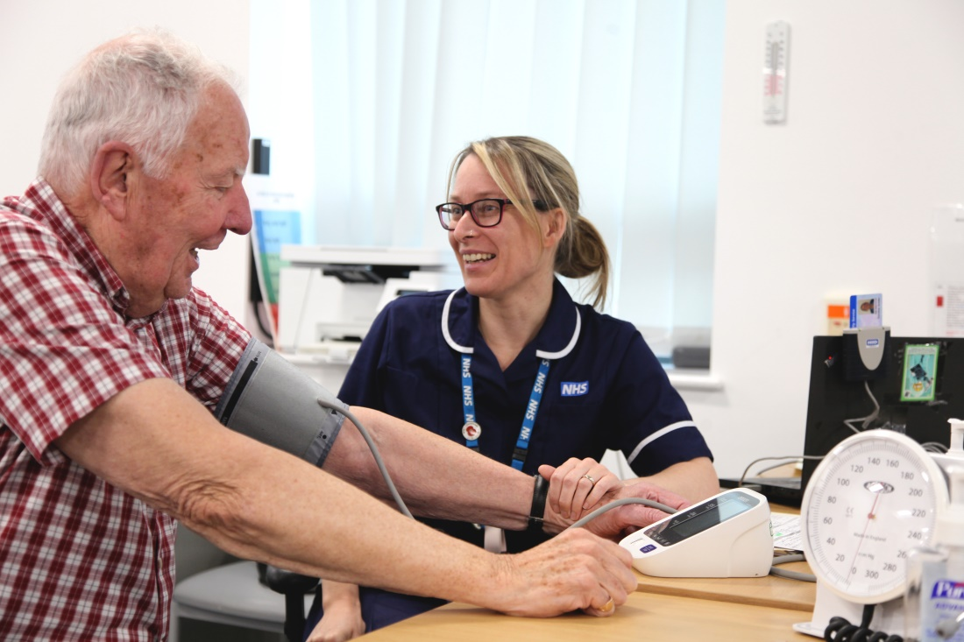
Quality Account
Paula Simpson Chief Nurse and Director of Infection Prevention and Control
Annual Members’ Meeting 2022-23

Slide 23
Quality Account
Quality Reports are annual reports that all providers of NHS services in England have a statutory duty to produce
NHS Foundation Trusts are not required to include a quality report in their annual report for 2022/23
Primary legislation continues to require providers of NHS services to prepare a Quality Account
It was NOT a requirement to obtain external stakeholder reports this year, however, we have invited partners to offer feedback on the report
Annual Members’ Meeting 2022-23

Slide 24
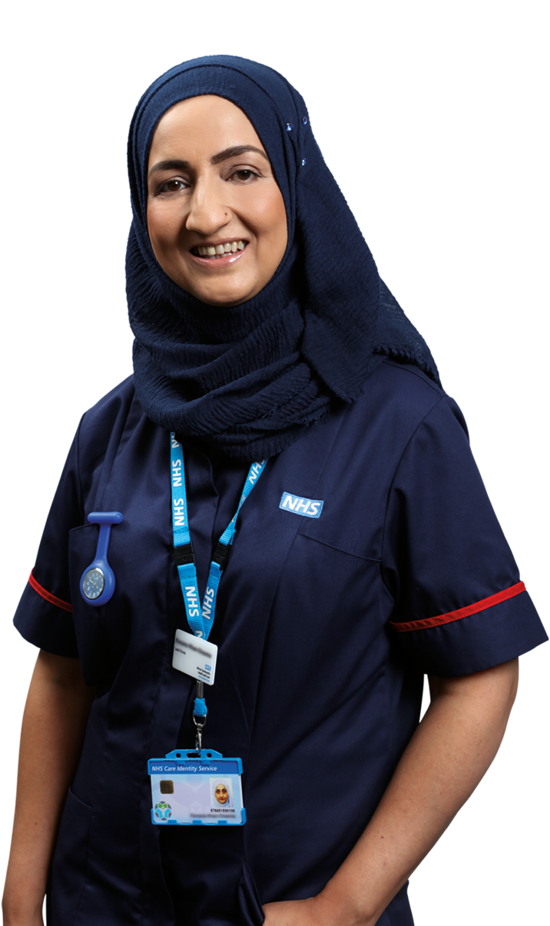
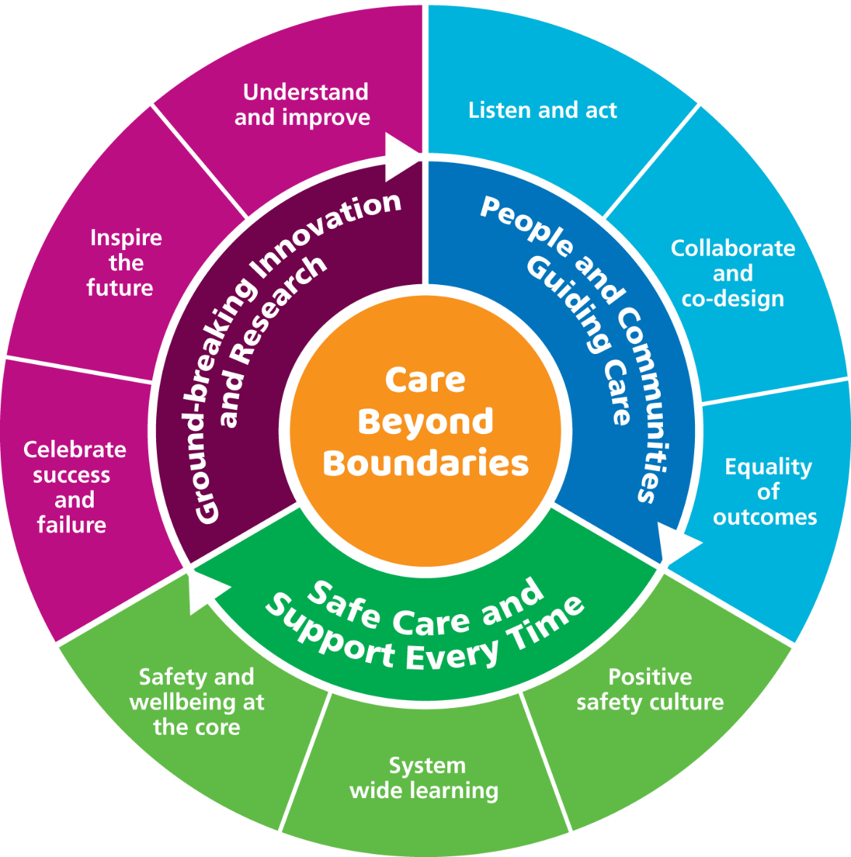
Culture of high quality sustainable care
Annual Members’ Meeting 2022-23

Slide 25
Safe care and treatment every time
Implementation of Patient safety incident response framework
Employed 2 Patient Safety Partners
Introduced national patient safety curriculum – trained 73% of staff
Psychological safety of staff
System wide Schwartz rounds
125 Freedom to speak up champions
Continued focus of learning from incidents
System wide reviews and shared learning
Zero never events
Annual Members’ Meeting 2022-23

Slide 26
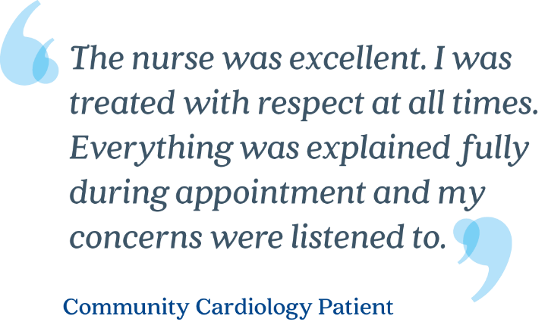
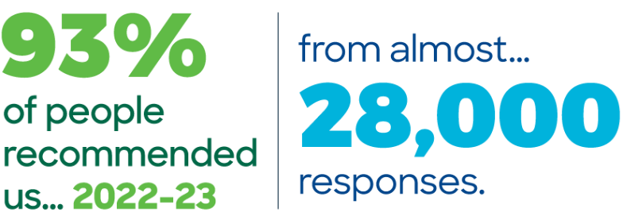
Learning, continuous improvement and innovation
Annual Members’ Meeting 2022-23

Slide 27
People and communities leading care
‘Your Voice’ and ‘INVOLVE (youth)’ groups continued to meet
Successful co-production and service development
Development of the Palliative Care Patient Information Leaflet
Development and roll out of the Reasonable Adjustments template and associated resources
Electronic Patient Record Project
Infection Prevention & Control Digital portal for communities, patients and partners
Review and development of Young People’s website and social media platforms
Annual Members’ Meeting 2022-23

Slide 28
Ground breaking research and innovation
Quality Service Improvement and Redesign skills development
15 trained at expert level
21 quality champions
Beyond Boundaries campaign
Twice yearly celebration events
Quality improvement faculty established
Service developments
Home First
Annual Members’ Meeting 2022-23

Slide 29
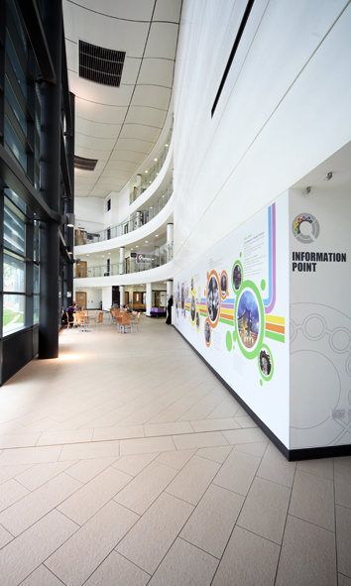
Report from the Council of Governors
Alison Hughes Director of Corporate Affairs
Annual Members’ Meeting 2022-23
Notes:
The Trust continues to have a strong and representative membership through 7,835 members, both public and staff. During 2018-19 the Trust continued to recruit young members through initiatives with local schools and the ‘Young Chamber’ in Wirral and saw a positive impact on membership numbers with over 1,000 young members (aged 16-21 years) signed up to the Trust. The public membership in the Rest of England constituency remains a priority for the Trust with a detailed action plan already in place.
The Council of Governors is keen to identify opportunities to engage with members and during 2018-19, the ‘Your Voice’ group continued to meet but with an expanded membership to include governors and more members. This group continues to evolve but has provided useful feedback and reflections on the meaning of membership to support a refresh of the Trust’s membership strategy.
During 2018-19 the Council of Governors participated in walkrounds and service visits with Non-Executive Directors providing another opportunity to engage with Trust members and service users. Our governors are also invited to numerous events during the financial year to support a greater understanding of the Trust and to further develop and strengthen relationships. We are always delighted to have governors participate in judging the annual HEART Awards and value the perspective and enthusiasm they bring to this process.
The Trust is committed to improving the health and wellbeing of patients and staff, ensuring it contributes positively to the lives of the local communities.
This was illustrated in 2018-19 with some of the following key activities;
The Trust continues to have a strong and representative membership through 7,835 members, both public and staff. During 2018-19 the Trust continued to recruit young members through initiatives with local schools and the ‘Young Chamber’ in Wirral and saw a positive impact on membership numbers with over 1,000 young members (aged 16-21 years) signed up to the Trust. The public membership in the Rest of England constituency remains a priority for the Trust with a detailed action plan already in place.
The Council of Governors is keen to identify opportunities to engage with members and during 2018-19, the ‘Your Voice’ group continued to meet but with an expanded membership to include governors and more members. This group continues to evolve but has provided useful feedback and reflections on the meaning of membership to support a refresh of the Trust’s membership strategy.
During 2018-19 the Council of Governors participated in walkrounds and service visits with Non-Executive Directors providing another opportunity to engage with Trust members and service users. Our governors are also invited to numerous events during the financial year to support a greater understanding of the Trust and to further develop and strengthen relationships. We are always delighted to have governors participate in judging the annual HEART Awards and value the perspective and enthusiasm they bring to this process.
The Trust is committed to improving the health and wellbeing of patients and staff, ensuring it contributes positively to the lives of the local communities.
This was illustrated in 2018-19 with some of the following key activities;

Slide 30
Public Governors
Staff and Appointed Governors
Birkenhead
Geoff Dormand
Vacancy
Vacancy
Wallasey
Gary Kelly-Hartley
Vacancy
Vacancy
Rest of England
Vacancy
Staff
Jenna Brassington, Physiotherapy
Lauren Francom, Communications & Marketing
Wirral West
Lynn Collins (Lead Governor)
Veronica Morris
Wirral South and Neston
Kevin Sharkey
Frieda Rimmer
Appointed Governors
Eve Collins, The University of Chester
Karen Prior, Healthwatch Wirral Manager
Annual Members’ Meeting 2022-23

Slide 31
Elections
We held elections in autumn 2022 with 5 public governor seats and 1 staff governor seat up for re-election
We were delighted to welcome:
Veronica Morris, public governor, Wirral West
Kevin Sharkey, public governor, Wirral South & Neston
Jenna Brassington, staff governor
We extend our thanks to governors who left the Council at the end of their tenure:
Jan Gidman, public governor, Rest of England
Fahim Sayid, public governor, Birkenhead
Jan Hegarty, staff governor
George Taylor, staff governor
Annual Members’ Meeting 2022-23
Notes:
The Trust has kept in regular contact with governors throughout the COVID-19 health emergency. Council of Governors meetings have continued during the pandemic.

Slide 32
CoG business during 2022-23
The Council of Governors met formally on 3 occasions and held 2 informal development sessions
Key business included
The governors formally appointed a new Non-Executive Director/Audit Chair for the Trust
The governors established a sub-group to lead the process to appoint new external auditors for the Trust which resulted in the successful appointment of Grant Thornton
The governor Remuneration and Nomination sub-group convened to agree the process for the reappointment of one Non-Executive Director and the Trust Chair (due in September 2023)
The governors supported the judging process for the Team WCHC Awards 2022
The governors received regular reports on the delivery of the Trust Five Year Organisational Strategy
Annual Members’ Meeting 2022-23

Slide 33
Membership
At the end of 2022-23 the Trust had 8,031 members
5,927 public members
2,104 staff members
The ‘Your Voice’ and INVOLVE groups provide a forum for our members and governors to engage with the Trust and each other to share the views of the public and to:
improve the experiences of people receiving care from the Trust
share patient, service user and public feedback intelligence including compliments, concerns and learning from complaints and the national Friends and Family (FFT) score
report to the group on the patient and service user experience aspects of the Trust’s annual quality goals
input into the development of new quality goals (following governor input)
contribute and share views on service redesign and key projects
Annual Members’ Meeting 2022-23
Notes:
During 2022-23 the members of the Your Voice group supported the Trust with the introduction of the PLACE framework to review buildings across the Trust estate, provided feedback on the Trust’s new public website and contributed to the development of a series of patient information leaflets including Community Nursing, complaints and Hand Hygiene.

Slide 34
Future Council of Governor elections
The next elections for public and staff governors will take place in Spring 2024, as amended in the FT constitution
Constituency | Seats
Birkenhead | 2
Rest of England | 1
Staff | 1
Wallasey | 3
Wirral West | 1
Annual Members’ Meeting 2022-23
Notes:
a person appointed by the CoG who, in the opinion of the governing body, has the knowledge, experience and skills required to contribute to the effective governance and success of the organisation
The appointment of a person who is not a serving governor, is a valuable and successful method of resolving a knowledge, experience or skills gap and supports succession planning
1. No alignment to a constituency
2. For a period of 12-months allowing the opportunity to stand for election at the next round
3. No requirement to stand for election (BUT if not they leave after 12- months)
4. The number of shadow governors will equal the number of vacant seats +/- (i.e., currently 5 seats)
5. Informal selection process with brief personal statement / EOIs on why and skills/expertise (Lead Governor and Chair lead)

Slide 35
Shadow governors
The Trust is actively seeking Shadow Governors to join the CoG to support engagement and future succession planning
Shadow Governor
a person appointed by the CoG who has the knowledge, experience and skills required to contribute but is not elected and therefore does not carry the same statutory duties
No alignment to a constituency
For a period of 12-months allowing the opportunity to stand for election at the next round
No requirement to stand for election
The number of shadow governors will equal the number of vacant seats +/- (ie, currently 5 seats)
Informal selection process with brief personal statement / EOIs on why and skills / expertise
Annual Members’ Meeting 2022-23
Notes:
a person appointed by the CoG who, in the opinion of the governing body, has the knowledge, experience and skills required to contribute to the effective governance and success of the organisation
The appointment of a person who is not a serving governor, is a valuable and successful method of resolving a knowledge, experience or skills gap and supports succession planning
1. No alignment to a constituency
2. For a period of 12-months allowing the opportunity to stand for election at the next round
3. No requirement to stand for election (BUT if not they leave after 12- months)
4. The number of shadow governors will equal the number of vacant seats +/- (i.e., currently 5 seats)
5. Informal selection process with brief personal statement / EOIs on why and skills/expertise (Lead Governor and Chair lead)

Slide 36
How to contact your governors?
The Council of Governors is supported by the Director of Corporate Affairs
You can contact any public or staff governor via the trust’s corporate office on 0151 651 3939 or via a contact form on our public website https://www.wchc.nhs.uk/about/board-governors/contacting-our-public-governors/
All governors also attend many of the Trust’s events and look forward to meeting with and speaking to members
Anybody interested in joining the Your Voice Group is encouraged to visit the following link on the Trust’s public website - Engagement Groups - Wirral Community Health and Care NHS Foundation Trust (wchc.nhs.uk)
Don’t forget the Trust Board of Directors meets in public bi-monthly and all agendas and papers are published on our website
Next meeting in Wirral - 13 December 2023 at 2.00pm
Annual Members’ Meeting 2022-23

Slide 37
Looking ahead
Karen Howell Chief Executive
Annual Members’ Meeting 2022-23

Slide 38
Looking ahead
In delivering the second year of our Five-Year Organisational Strategy for 2022-27 we will
Continue the focus on our holistic and proactive care delivering the benefits of Place-based working and Integrated Care Systems
We will be actively contributing to the development of the ICS for Cheshire and Merseyside
We will continue to improve on addressing health inequalities through service delivery, support local employment and create opportunities for people from more deprived communities
As an Anchor Institution, we will add social value through our approach to employment, procurement, and sustainability to support stronger, healthier communities
We will ensure financial sustainability and value for money so that we can continue to invest in high quality care
We will continue to listen and engage with our staff
We will receive and respond to the findings of the CQC inspection
Annual Members’ Meeting 2022-23
Notes:
We are looking forward to the coming year and delivering the second year of our Five-Year Organisational Strategy for 2022-27, which can be found on our website.
We expect a continuing focus on holistic and proactive care, delivering the benefits of Place-based working and Integrated Care Systems. Through the work described in our Inclusion & Health Inequalities strategy we will continue to improve our approach to addressing health inequalities through service delivery and how we support local employment and create opportunities for people from more deprived communities. Wirral Community Health & Care NHS Foundation Trust Annual Report and Accounts 2022-23 17

Slide 40
Questions & Answers
We invited you to submit questions in advance of the meeting and any received will be responded to by the relevant Director
All questions will be responded to with the answers published on our website - wchc.nhs.uk
Annual Members’ Meeting 2022-23

