Slide 1
IPC Bitesize Training for Adult Social Care
2023 - 2024
Infection Prevention Control Service

Slide 2
UTI and Hydration

Slide 3
Why is there a need to improve UTI management?
Urinary Tract Infections (UTIs) are the second most common reason for antibiotics being prescribed in the community, with Wirral being one of the highest antibiotic prescribers for UTIs in England. We must use antibiotics appropriately and only when required to prevent antimicrobial resistance.
We are high prescribers in the older population 70+
We have among the highest rate for admissions to hospital for UTI in England particularly in 70+ population
Over use of antibiotics causes antibiotic resistance, so antibiotics no longer work
We need to focus on preventing UTI to keep our older people well

Slide 4
Introduction video
https://m.youtube.com/watch?v=rZ5T1Cz7DHQ&feature=youtu.be

Slide 5
How much fluid does an older
person need?
Most people need 1500 to 2000ml of fluid daily to stay healthy
If people have low body weight this may be less:
Weight 40 – 50kg: 1200-1500ml
Weight 35-40kg: 1000-1200ml
(based on 30ml/kg daily)
Some people may have fluid restrictions that require a careful balance of intake and output e.g. kidney impairment

Slide 6
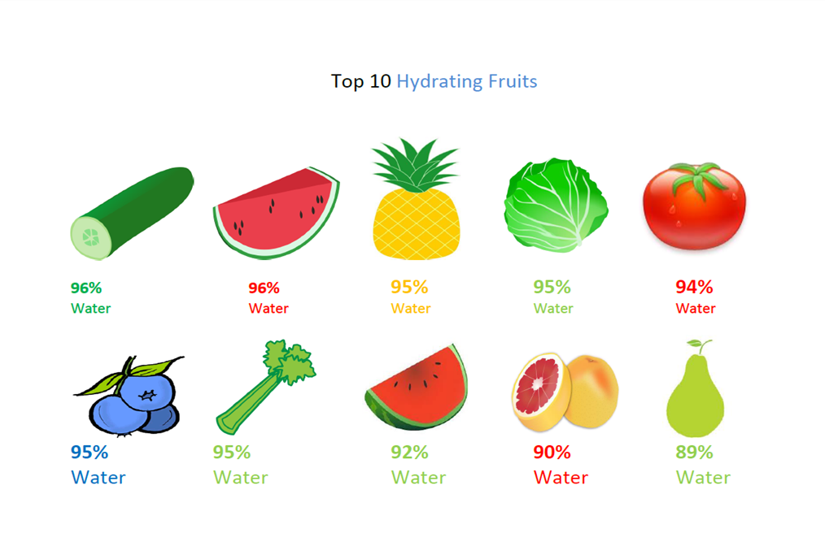
Improving fluid intake
Little and often offers and prompts - make every contact count
Fruit and veg
High water content fruit and veg
Melons; watermelon, cantaloupe (92% water)
Strawberries / peaches
Citrus; oranges, grapefruit, tangerines – also high in fibre
Cucumber / lettuce / celery
Tomatoes / peppers
Tinned pears – can be mashed easily

Slide 7
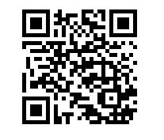
Evaluation
Infection Prevention and Control - Wirral Community Health and Care NHS Foundation Trust (wchc.nhs.uk)
https://www.smartsurvey.co.uk/s/4AMDK6/

