Slide 1


IPC Bitesize Training
for Adult Social Care
Infection Prevention Control Service

Slide 2
Standard and Transmission Based Precautions

Slide 3
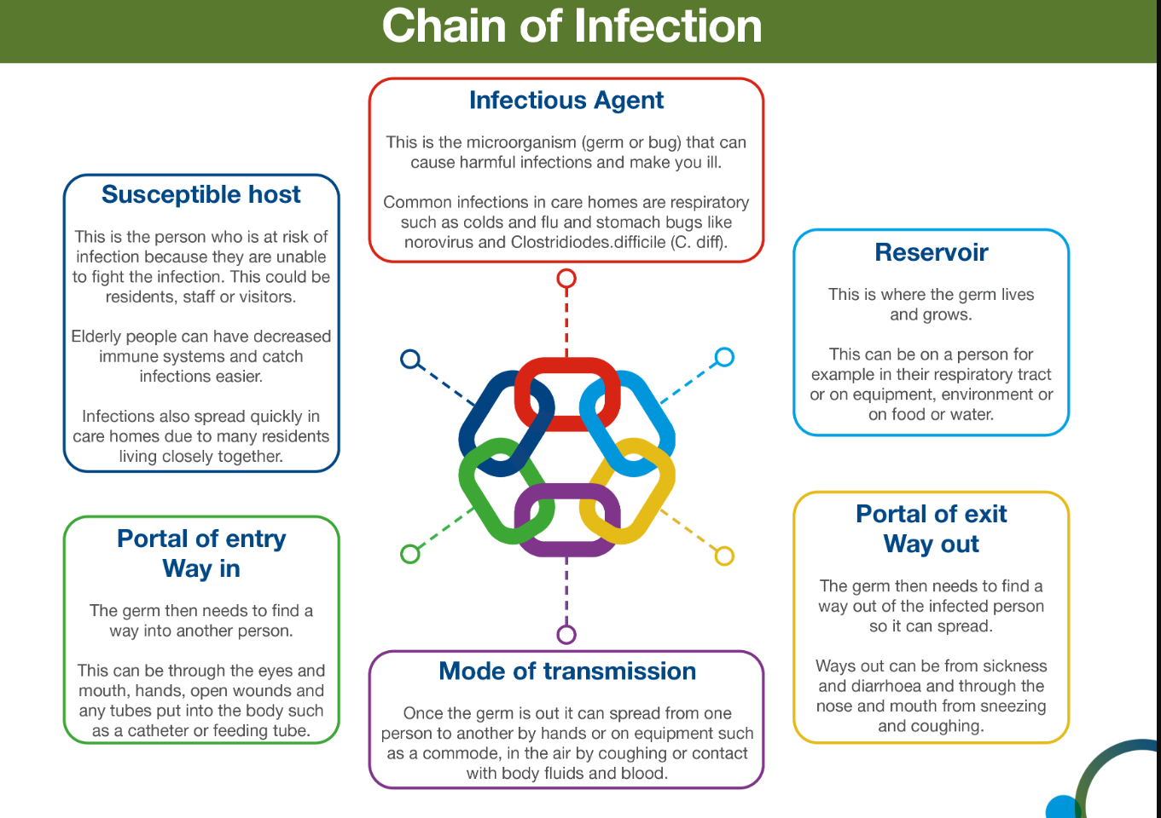

Slide 4
Standard infection control precautions (SICPs)
The National Infection Prevention and Control Manual (Updated May 2024) for England states that SICPS are to be used by all staff, in all care settings, for all patients/residents/service users whether infection is known to be present or not
1. Patient placement | 6. Safe management of care equipment
2. Hand hygiene | 7. Safe management of healthcare linen
3. Respiratory and cough hygiene | 8. Safe management of blood and body fluids
4. Personal Protective Equipment (PPE) | 9. Safe disposal of waste (including sharps)
5. Safe management of the care environment | 10. Occupational safety / managing prevention of exposure (including sharps)

Slide 5
Transmission Based Precautions ( TBP)
Standard infection control precautions (SICP) may be insufficient to prevent cross transmission of specific infectious agents and additional precautions called “transmission based precautions” (TBP) may be required when caring for people with known or suspected infection or colonisation.
Transmission based precautions are categorised by the route of transmission of infectious agents (some infectious agents can be transmitted by more than one route).Types of precautions are:
Contact precautions
Droplet precautions
Airborne precautions

Slide 6
Transmission Based Precautions (TBP)
Contact precautions - Used to prevent and control infections that spread via direct contact with the person or indirectly from the person’s immediate care environment (including care equipment). This is the most common route of cross-infection transmission.
Droplet precautions - Measures used to prevent, and control infections spread over short distances (at least 1 metre) via droplets from the respiratory tract of one individual directly onto a mucosal surface or conjunctivae of another individual.
Airborne precautions - Measures used to prevent, and control infection spread without necessarily having close person contact via aerosols from the respiratory tract of one individual directly onto a mucosal surface or conjunctivae of another individual.
Clinical judgement and decisions should be made by staff on what additional precautions are required and this will be based on:
  Suspected or known infectious agents
  Severity of the illness caused
  Transmission route of the infectious agents
  Care setting and procedures undertaken.

Slide 7
Preventing spread of infection
Encourage people to have their Flu and COVID-19 seasonal vaccinations and boosters, this offers the best protection against the viruses. Maintain an accurate, up to date record of resident/service user vaccinations.
Follow and reinforce basic infection prevention with good hand and respiratory hygiene and correct use of personal protective equipment.
Maintain high standards of environmental cleanliness using appropriate disinfection products that can be diluted to 1,000 ppm of available chlorine,
Maintain good ventilation in the setting and ensure well maintained supplies/stocks of PPE and hand hygiene products.
Visitors should not visit the setting if feeling unwell.
Any person displaying symptoms of Acute Respiratory Illness (ARI) should follow most recent guidance, remember this can sometimes change quickly and without notice.

Slide 8
Thank you for listening….
Contacting the team:-
Email address ipc.wirralct@nhs.net or telephone 0151 604 7750
IPC DIGITAL HUB- Infection Prevention and Control - Wirral Community Health and Care NHS Foundation Trust (wchc.nhs.uk)
Please complete post session evaluation via the QR code

