Slide 1

Infection Prevention Control Service – IPC champions programme 2024/25
Audit / Mattress checks

Slide 2
Welcome
Refreshments
Phones
Toilets
Health and safety (fire exits)
Meet the IPC team

Slide 3
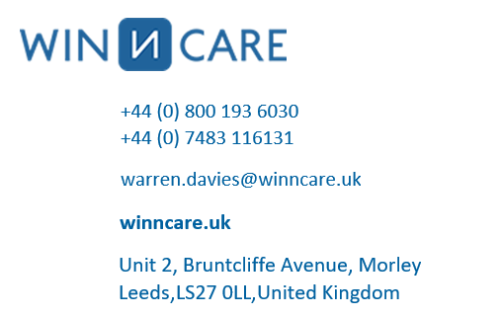
Maintaining mattresses in care homes with guest speaker

Slide 4
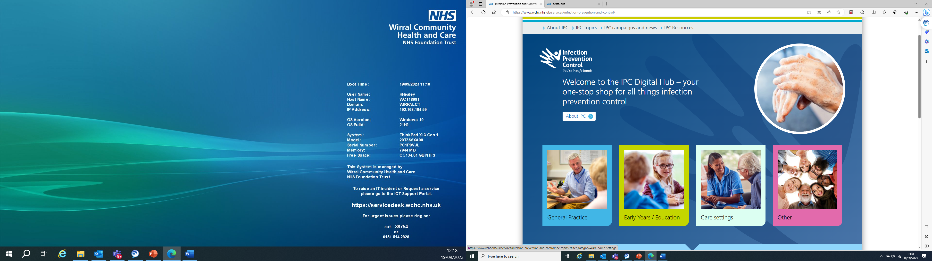
Where to find your self audit tools IPC digital Hub

Slide 5
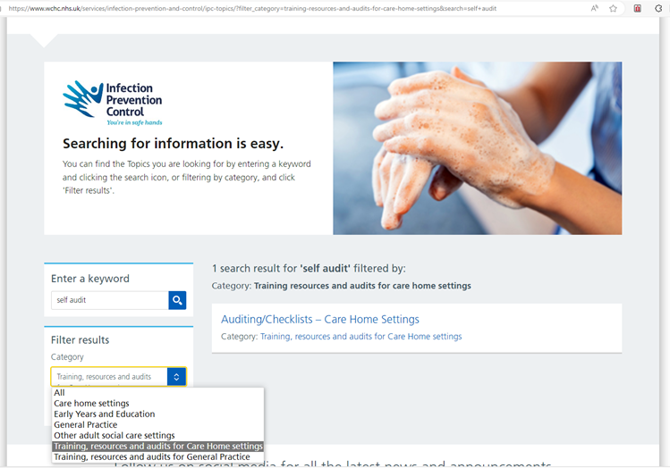
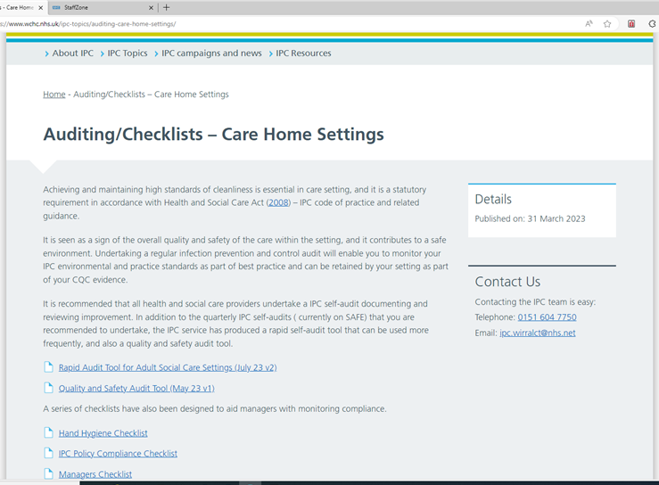
Where to find your self audit tools… IPC digital Hub
Infection Prevention and Control - Wirral Community Health and Care NHS Foundation Trust (wchc.nhs.uk)
Auditing/Checklists - Care Home Settings - Wirral Community Health and Care NHS Foundation Trust (wchc.nhs.uk)

Slide 6
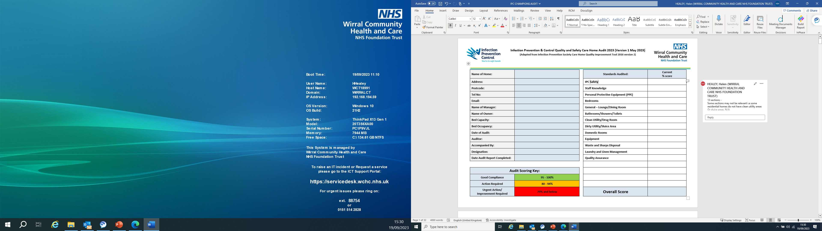
Lets look at the audit tool..

Slide 7
How often should we be completing Audit
Quality and Safety Audit (Full Audit tool) recommended to be done annually
Rapid audit tool for adult social care settings – recommended to be done quarterly (every 3-6 months)
Both should have action plans that are monitored regularly by the provider
Auditing/Checklists - Care Home Settings - Wirral Community Health and Care NHS Foundation Trust (wchc.nhs.uk)

Slide 8
There are also other checklists to be completed which will support and evidence good IPC standards. These are:
Hand hygiene checks should be completed at least monthly and frequency increased during outbreaks of infection https://www.wchc.nhs.uk/wp-content/uploads/2023/08/Hand-Hygiene-Checklist.docx
PPE checks should be completed regularly and increased during outbreaks of infection https://www.wchc.nhs.uk/wp-content/uploads/2023/08/PPE-Checklist.docx
Mattress checks should be completed monthly https://www.wchc.nhs.uk/wp-content/uploads/2023/08/2023-24-Care-Home-Mattress-Audit-Tool-v3-May-23.docx

Slide 9
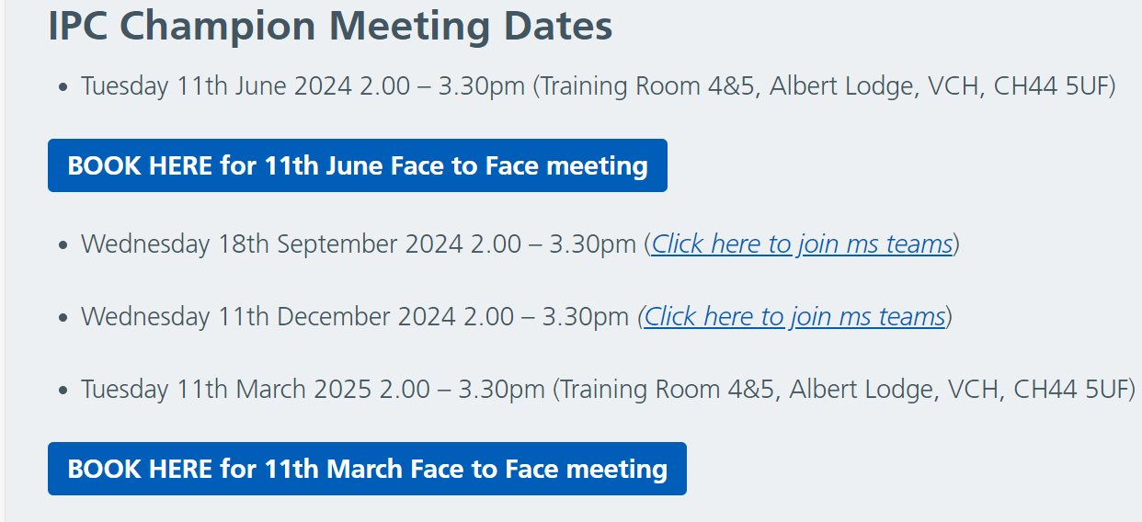
Thank you for listening
Book in your next IPC champions meeting today
Champions of Infection Control - Wirral Community Health and Care NHS Foundation Trust (wchc.nhs.uk)

