Slide 1
Healthy Lifestyle
Weight and Diabetes
Presented by:
Community Dietitian

Slide 2
Weight and Diabetes
In general, we gain weight when we take in more calories than out body burns up.
A calorie (kcal) is a unit of energy.
National recommendations are that men need around 2,500kcal a day
and that women need around 2,000kcal a day, to maintain a healthy weight.
Being overweight makes it more difficult to manage diabetes.

Slide 3
Are you a healthy weight for your height?
Calculated using Body Mass Index, BMI
BMI = weight (kg)
height (meters²)
Risk category | Underweight- malnutrition risk | Lower risk of lifestyle diseases | Increased risk of lifestyle diseases | High risk of lifestyle diseases
BMI | Less than 18.5 | 18.5 – 24.9 (18.5-22.9 South Asian populations) | 25-29.9 (23-26.9 South Asian populations) | 30 + (27.9 + South Asian populations)
What to do? | Seek advice You may benefit from gaining weight | Ensure heart healthy food options | Reduce calorie intake and increase exercise | Seek advice Consider a weight management programme

Slide 4
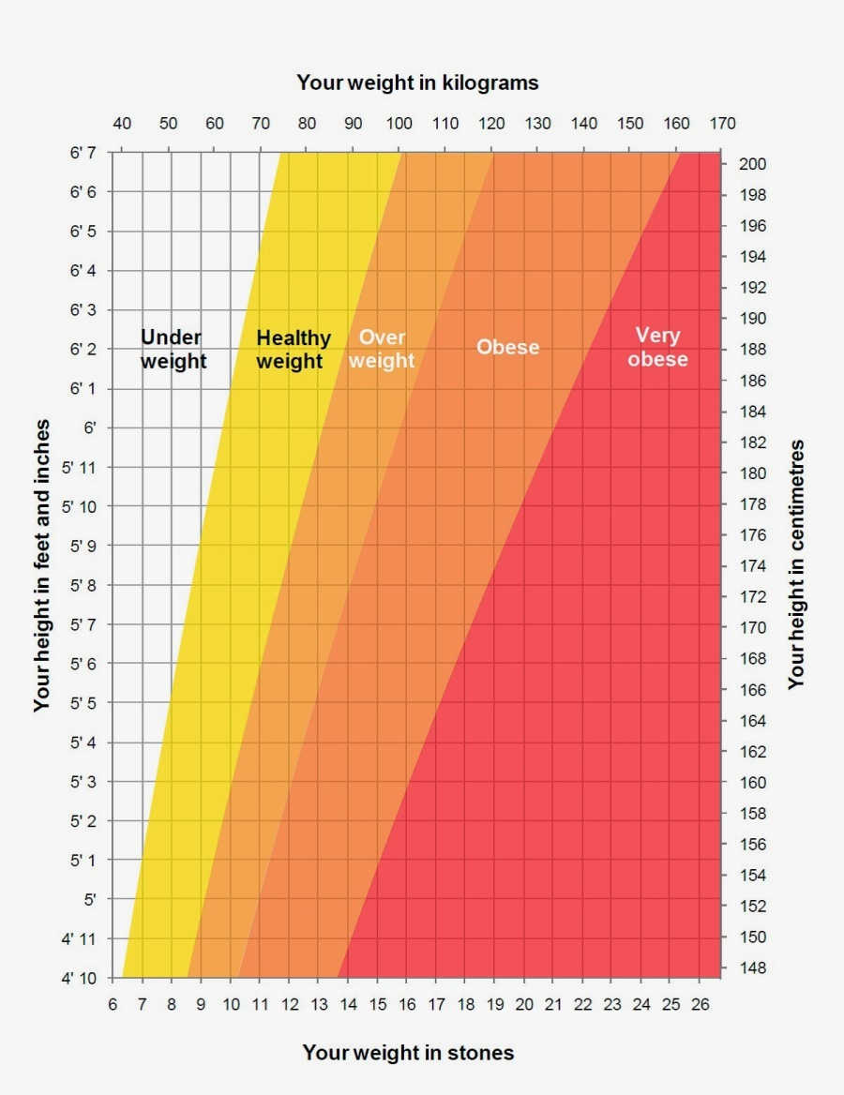

Slide 5
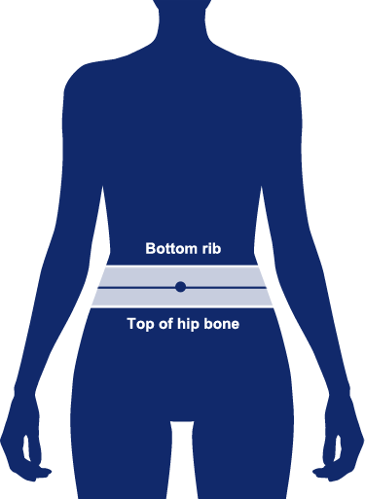
Waist measurement is important
 | Men | Women | South Asian Men | South Asian Women
Healthy Measurement | Less than 94cm (37 inches) | Less than 80cm (31.5 inches) | Less than 90cm (35inches) | Less than 80cm (31.5 inches)
At increased risk | Over 94cm (37 inches) | Over 80cm (31.5inches) | Over 90cm (35 inches)
At high risk | Over 102cm (40 inches) | Over 88cm (34.5 inches) | Over 94cm (37 inches) | Over 80cm (31.5 inches)
https://www.diabetes.org.uk/preventing-type-2-diabetes/waist-measurement

