Slide 1
Carbohydrate Awareness
Estimating the Carbohydrate
content of foods and drinks
Presented by:
Community Dietitian

Slide 2
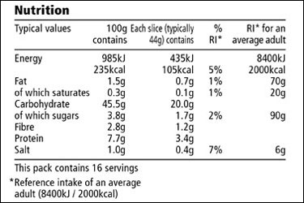
Food labels
Look at total carbohydrate, not ‘of which sugars’

Slide 3
Rice

Slide 4
Lemon slice

Slide 5
Chicken soup

Slide 7
Cous cous

Slide 8
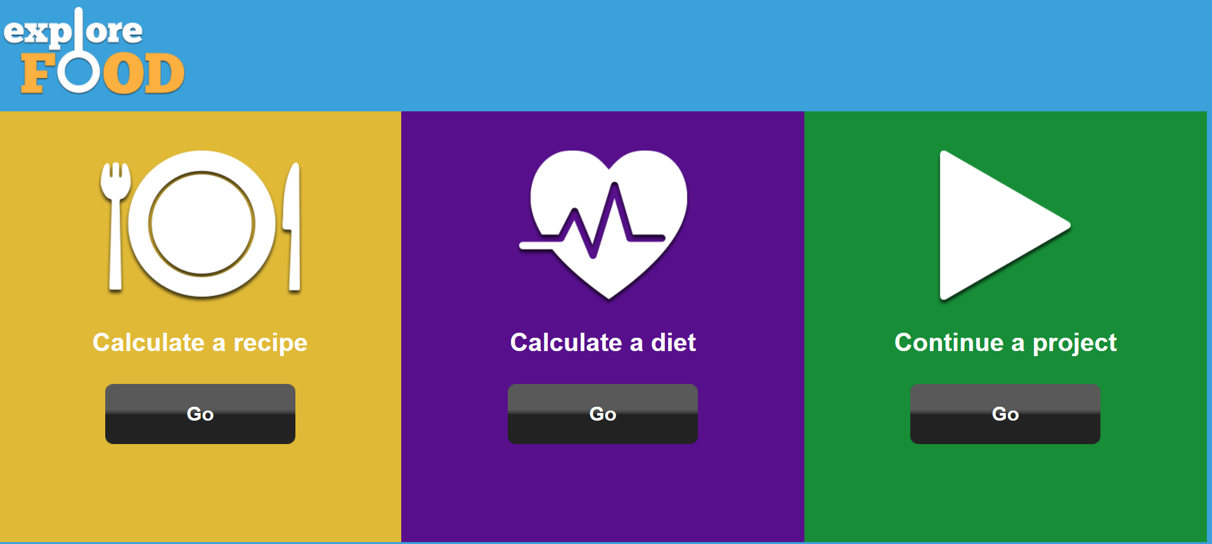
Visual Estimation

Slide 9
Visual Estimation
Carbs and Cals

Slide 10
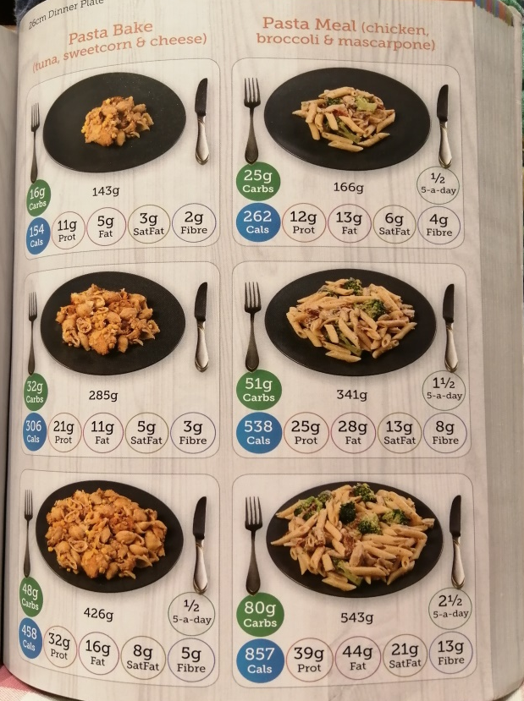
Visual Estimation
Carbs and Cals

Slide 11
10g carbs list

Slide 12
Visual Estimation

Slide 13
Carbohydrate
reference tables

Slide 15
How much
carbohydrate
am I having?

Slide 16
How much carbohydrate am I having?
Step 1:
write down what you
eat and drink for a day

Slide 17
How much carbohydrate am I having?
Step 2: does it contain carbohydrate and how much?

Slide 18
How much carbohydrate am I having?
Step 2: does it contain carbohydrate and how much?
Egg and salad sandwich
Egg
Salad
Olive spread
2 medium slices granary bread
Apple

Slide 19
How much carbohydrate am I having?
Step 2: does it contain carbohydrate and how much?
Egg and salad sandwich
Egg 0
Salad 0
Olive spread 0
2 medium slices granary bread 15 x 2 = 30
Apple 15
TOTAL 45

Slide 20
What carbohydrates am I having?
Repeat this for each meal and add up the total
for the day

Slide 21
What carbohydrates am I having?
How much per day
How much per meal/how is it spread out
Are they high/low GI (quick/slow releasing)
Is there anything you want to change?

Slide 22
Carbohydrates
For more information about carbohydrates take a look at the other carbohydrate awareness recordings or book on to Diabetes Smart.

