Slide 1
Carbohydrate Awareness
Amount of Carbohydrate
Presented by:
Community Dietitian

Slide 2
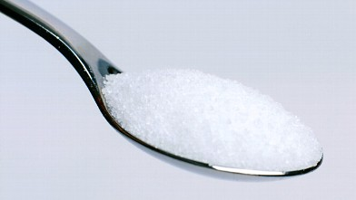
1 potato
(egg-sized)
2 teaspoons sugar
1 medium orange
1/3 pint (200ml) milk

Slide 3
1 potato (egg-sized)
2 teaspoons sugar
1 medium orange
1/3 pint (200ml) milk
All of these food portions contain 10g of carbohydrate
and so would raise blood glucose levels by a similar amount

Slide 4
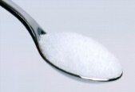
Carbohydrates
=
=

Slide 6
Carbohydrates
Remember all types of carbohydrate are broken down into glucose.
The amount of carbohydrate eaten is the biggest factor affecting blood glucose levels.

Slide 7
Carbohydrates
For more information about carbohydrates take a look at the other carbohydrate awareness recordings or book on to Diabetes Smart.

